Slide 1
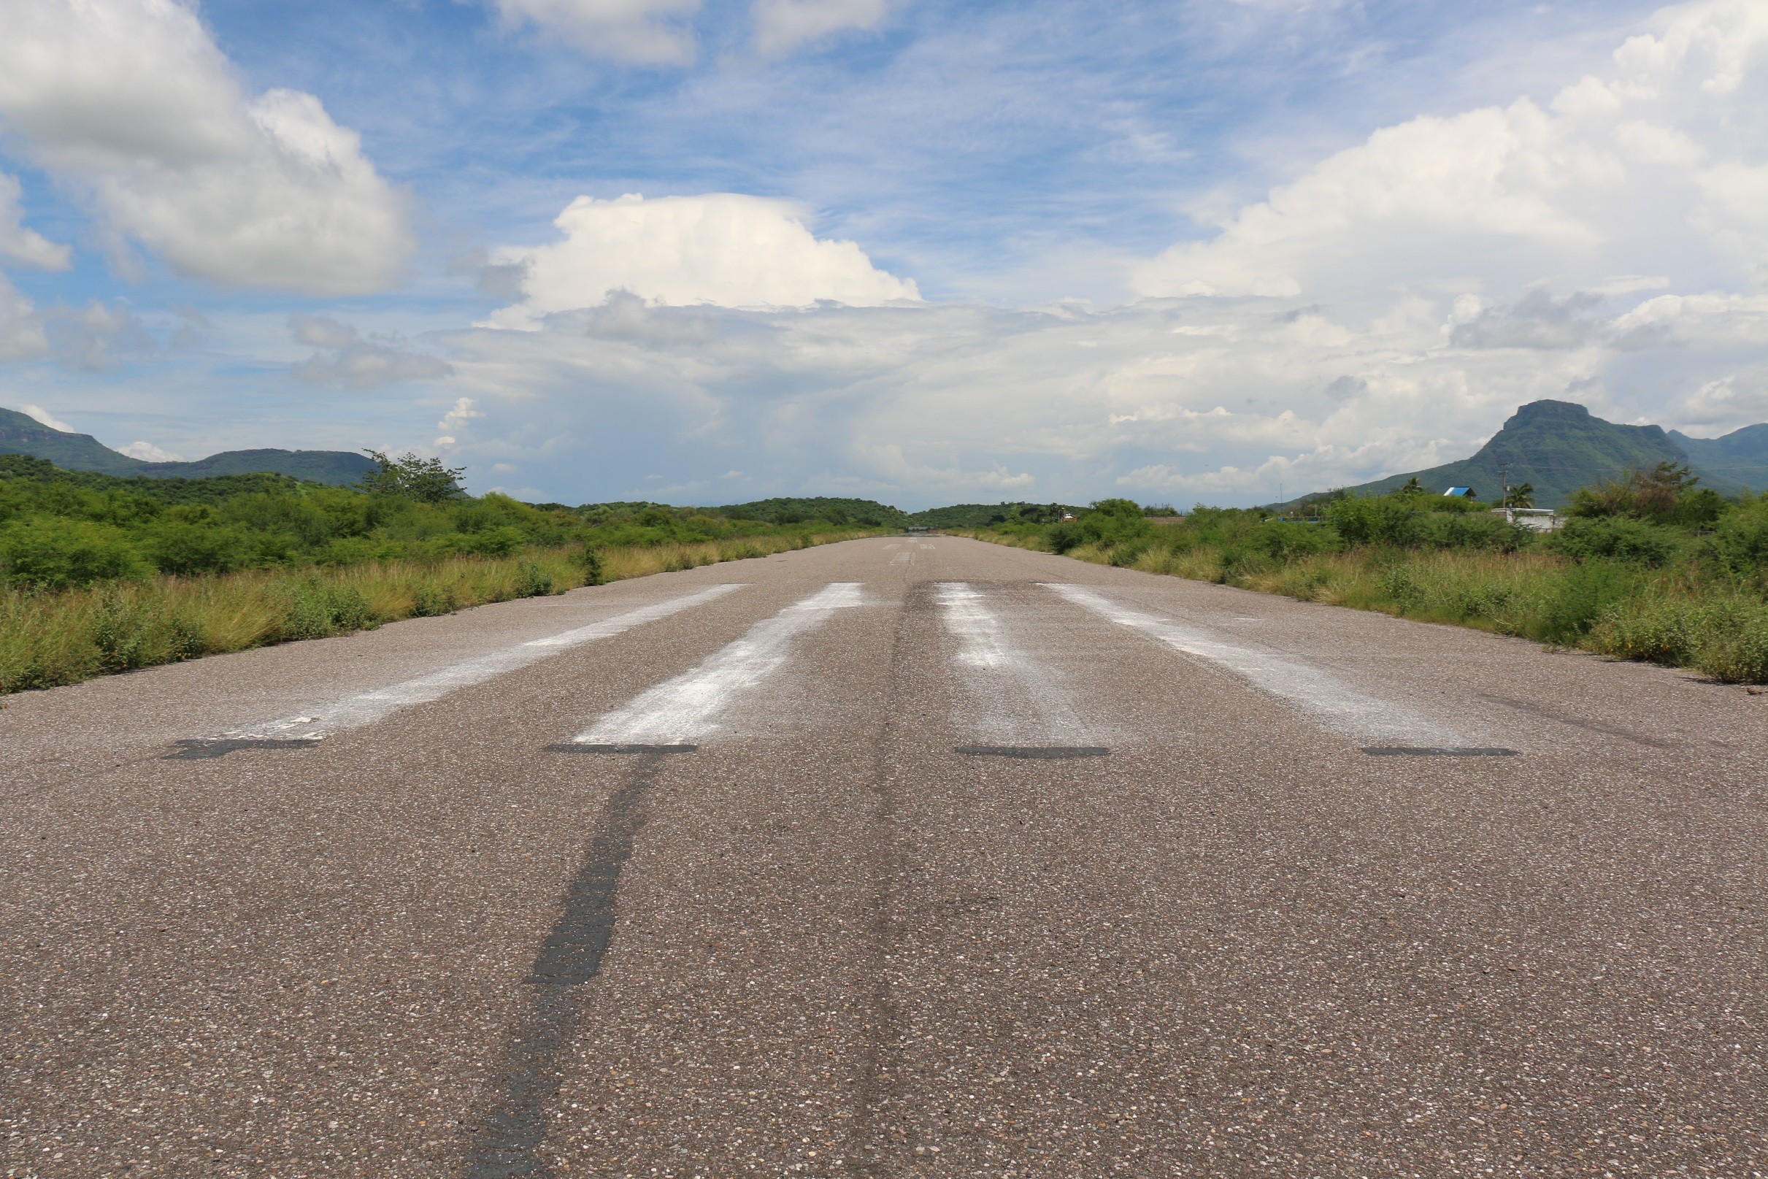
How to fly GA to Mexico
Host: Ranferi Denova
www.FlyGAMexico.com
Rev. 2023

Slide 2

About the host:
Mexican national, native Spanish speaker
Has lived in Mexico 7+ years
Has done multiple GA flights
Relationship with local AFAC agencies
Likes to network with other pilots

Slide 3
Is it safe to fly to Mexico?
In short: YES!
Have all docs ready.
Know what to expect.
Be courteous, always smile and have a friendly attitude.
Dress casual.
Try not to stand out.
If possible, have pesos handy.

Slide 4

Fun destinations to go to?
Monterrey (MMAN)
Tampico (MMTM)
Cancun (MMUN)
Zihuatanejo (MMZH)
Puerto Vallarta (MMPR)
Cabo (MMSL / MMSD)
Loreto (MMLT)
San Felipe (MMSF)

Slide 5
Aircraft Requirements
Airworthiness Certificate
Registration Certificate
Radio Station License (FCC, ~$170)
Mexican Liability Coverage
POH & Weight and Balance
Transponder w/ Mode C; 2-way Radio; 406 MHz ELT; Notarized letter from aircraft owner; 12-inch N-Number.
ADS-B Out using the 1090 MHz ES band required.

Slide 6
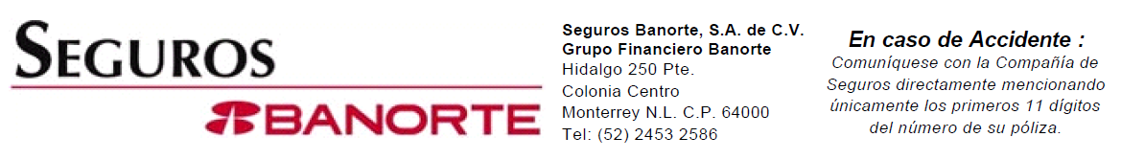
Mexican insurance coverage
Most US insurance covers Mexico already.
You can obtain Mexico-specific coverage for about $150/yr
Liability limit of at least $300,000 USD.
Insurance WILL BE asked for when landing and getting permits.

Slide 7
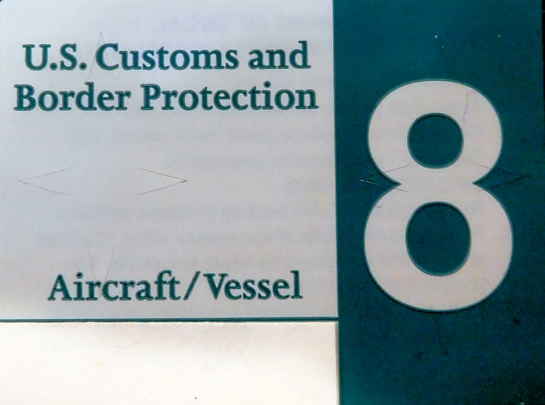
US Customs and Border Protection
Annual user fee decal
  $32.62
eAPIS manifest
  Free using gov website
  FlashPass $10-134, paid service, highly recommended.

Slide 8
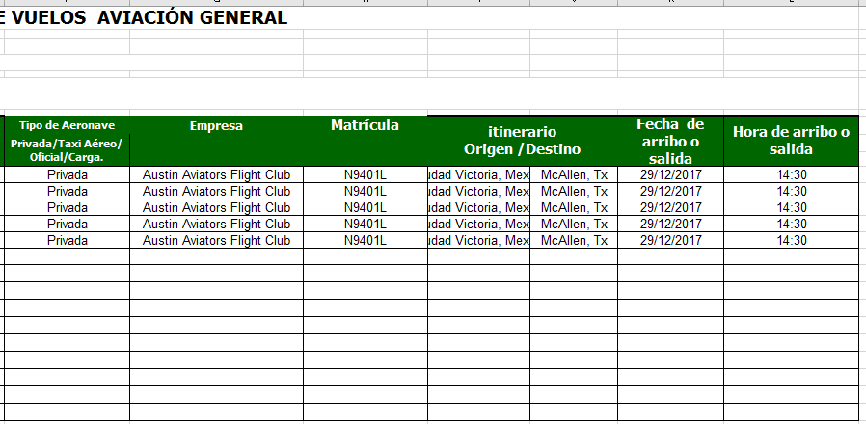
Instituto Nacional de Migración
Excel manifest document
Sent to INM via email
Easy to use, save template offline

Slide 9

Pilot Requirements
FAA Pilot Certificate
  English Proficient endorsement
Medical Certificate
  *BasicMed now approved!
Passport
FCC Radiotelephone Operator permit.

Slide 10
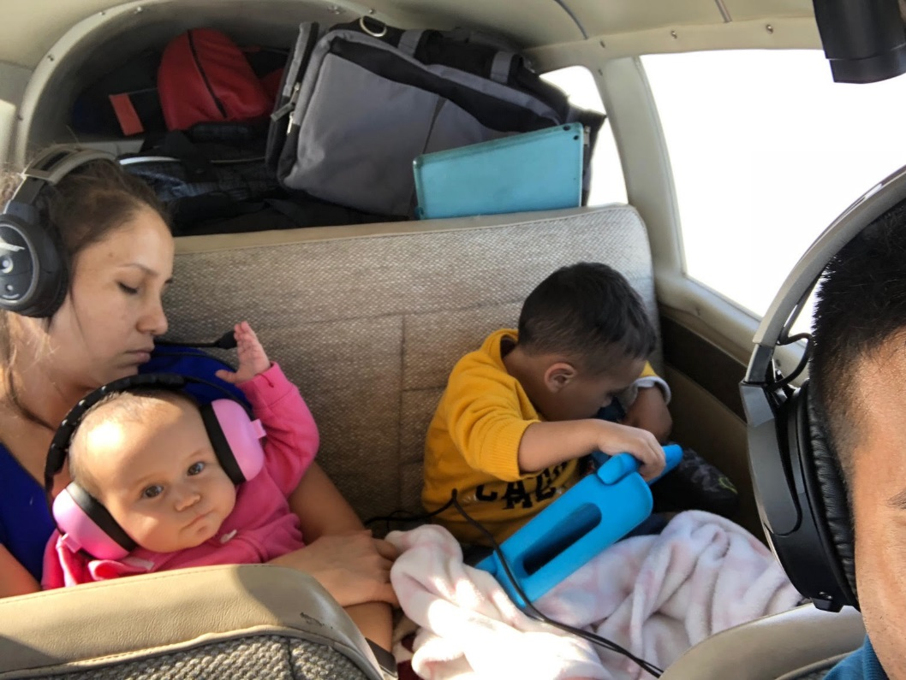
Passenger Requirements
Valid passport.
Minors traveling with one parent need a notarized letter.
Pesos!

Slide 11
Flight Planning
Instrument Flight Rules
  Must fly Victor or Upper-Juliet airways.
  High MEAs over central Mexico.
  Limited radar coverage. Must do position reports.
Visual Flight Rules
  Fly direct routes.
  Fly much lower than the MEA – watch out for terrain!
  ATC may not know where you are coming from or going to.

Slide 12
24 hours before USA Departure
Submit your eAPIS manifest to CBP. (Can be done up to 60 minutes before departure)
Submit your Mexican APIS manifest via email. Required to be done 24 hours before departure.
Plan your route, study the weather. File your flight plan if flying IFR.

Slide 13
1 hour before USA Departure
Re-send your Mexican APIS (required). Print a copy to take with you.
Submit your CBP eAPIS if you have not done so already.
Double and triple check that all crew/passengers and airplane have the requirements to fly.

Slide 14
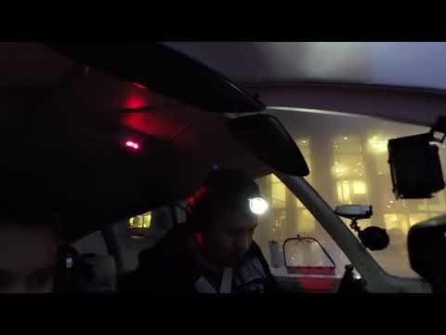
USA Departure
If IFR, pick up your clearance as normal.
IF VFR, pick up Flight Following.
No need for DVFR flying outbound.
Enjoy the flight!!

Slide 15
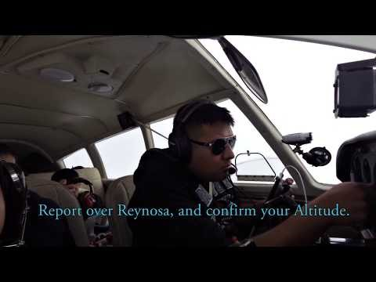
Crossing the border
US ATC
  “N123AB, you are leaving my airspace. Radar service is terminated, contact Reynosa Approach 127.20”
Contact Mexican ATC
  Announce your tail number and wait.
  Give current position and request
Continue your flight as usual.

Slide 16
Flying en-route in Mexico
IFR
  ATC will ask you to report at certain DME distances.
  Report over Compulsory Reporting Points if not in Radar Contact.
  Most airports do not have ATIS/AWOS.
  Use Jeppesen approach plates, or Mexican AIP plates.
    Subscription required for both
VFR
  Fly direct
  Contact ATC 10 miles before entering TMA (Terminal Control Area).
  If transient, announce current Position, Origin, Destination, Type of Aircraft.

Slide 17
Landing and taxiing
Must land at any AOE. Most authorized Mexican airports are AOE.
Some airports have specific spots to park when clearing customs.
  Ask for progressive taxi if unsure where to park.
Wait inside the airplane until escorted out.
  Smaller airports may allow you to exit. Ask ATC if unsure, or call AFAC prior to flight for exact local procedures.

Slide 18

Mexican dependencies to visit
INM – “Migracion” (immigration)
SAT – “Aduana” (customs)
AFAC – “Comandancia”, FAA equivalent office. Permits and authorizations.
SENEAM – “Despacho”, Flight Service Station. Open and Close flight plans. Weather information.
ASA – “Operaciones”, Fuel services and airport fees.

Slide 19
Initial arrival into Mexico
Many large airports will automatically close your flight plan now.
  If not, go to SENEAM and fill out a Flight Plan closure form. Take & Save.
Go to INM with your passports. Crew does not pay an entry fee. Passengers pay a $697 MXN entry fee, good for 180 days. (~$38 USD)
Go to AFAC for a Single or Multi-Entry permit if this is your first time of the year entering Mexico.
Pay landing fees if applicable with ASA. Also order cheap fuel at around $4.50/g through ASA.

Slide 20
AFAC Entry Forms
Single Entry
Multi Entry
Good for a single stay in Mexico of up to 6 months.
Costs the same as multi-entry
NOTE: Bring all docs with you.
Good for one calendar year
May be used an unlimited number of times.
You CANNOT stay beyond December 31st.

Slide 21
Departing AOE to another Mexican airport
Go to SENEAM to file a paper ICAO flight plan.
Take white copy of Flight Plan to AFAC to get it reviewed and stamped.
Visit ASA to pay any pending fees.
Take it back to SENEAM to get it reviewed, stamped, and signed.
Most airports only have Tower and Approach controllers. Get your clearance and taxi information with Tower.
Tower will give you your Departure Freq. “N123AB, winds calm. Cleared for takeoff Rwy 18. In the air contact Departure on 127.5”

Slide 22
Departing AEO back to the USA
Go to SENEAM to file a paper ICAO flight plan.
Take white copy of Flight Plan to INM. Clear outbound customs and return INM entry-permit. Pay fees if applicable, about ~$5 USD. INM has to stamp Flight Plan.
Take white copy of Flight Plan to AFAC to get it reviewed and stamped.
Visit ASA to pay any pending fees.
Take it back to SENEAM to get it reviewed, stamped, and signed.
Mexican APIS 24 hours before and 1 hour before.
CBP eAPIS 1 hour before, plus call AOE to give Notice of Arrival w/ ETA.

Slide 23
Crossing the border back to the USA
On IFR Flight Plan
On VFR Flight Plan
You will already have a transponder code from Mexican ATC.
Handshake between ATC agencies will automatically be done for you.
Contact FSS before crossing the border to get a discrete transponder code. 12XX
File an ICAO flight plan with the FAA.

Slide 24
Landing in the USA
First landing MUST be made at your closest AOE into the USA.
  Example: You would land in Laredo Tx if coming from Monterrey to Austin.
You can fly direct with an Overflight Exemption Permit.
Turn off all cameras and put cell phones away.
Do not exit the airplane until CBP tells you to. Wait inside no matter what.
Follow CBP instructions, and have passports ready.
Continue your flight to your final destination following traditional domestic SOPs.

Slide 25
Ranferi’s Pro Tips
You can pay a Handler to do all the paperwork for you. All you do is provide signatures. Fees range from $500-2,000 USD.
FAA & Jeppesen publish en-route L/H IFR charts for Mexico.
Jeppesen publishes IAP charts. Both Paper and EFB.
Mexico publishes a digital Aeronautical Information Publication with L/H en-route charts and IAP. AIP is in Spanish, some IAPs are in both English and Spanish.
Mexico secretly publishes digital VFR charts. They can be obtained via my website. They cannot be printed for commercial use, nor sold.

Slide 26
Ranferi’s Pro Tips
Don’t be in a rush. Make sure you have plenty of time for paperwork. It becomes easier the more times you do it.
Many airports don’t have FBOs. If they do, they are very expensive.
All airports are guarded by the Mexican military 24/7. Do not be afraid to leave your headset in the airplane.
VFR flight is only permitted during daytime. You must file IFR for night flight – not all airports have 24/7 service.
It is okay to greet the controller with “Buenos Dias, Buenas Tardes, Gracias, etc” in Spanish.

Slide 27
Ranferi’s Pro Tips
Highly recommend Monterrey Del Norte (MMAN) as your first international airport, as it is very GA friendly.
An “International” airport may not have a huge terminal. Some don’t have an ATM machine. Bring small bills, and pesos if possible.
It is NEVER okay to tip an official. It is okay to tip airport staff and employees if they offer help.
Whenever in doubt, ask to speak with “El Comandante.”
Pilots are often called “Capitan” or “Capi” in Mexico. We do get extra VIP treatment, even if you’re flying a Cessna 152.
There are new RNAV (GNSS) approaches being developed*

Slide 28





Fly GA Mexico 2023 flyout:
Cuatro Cienegas, March 11-13th

Slide 29
Thank you!
Copy of presentation available tomorrow morning:
www.FlyGAMexico.com/presentation

Slide 30
Useful links
CBP decal
FCC Radio Station License (airplane + pilot)
eAPIS
Mexican Insurance

